Slide 1
Lesson 1: Systems
Year 5 – Computing systems and networks – Systems and searching
Notes:
Last updated: 31-01-22
Resources are updated regularly — the latest version is available at: ncce.io/tcc.
This resource is licensed under the Open Government Licence, version 3. For more information on this licence, see ncce.io/ogl.

Slide 2
Lesson 1: Systems
Objectives
To explain that computers can be connected together to form systems
I can show that systems are built using a number of parts
I can describe the input, process, and output of a digital system
I can explain that computer systems communicate with other devices

Slide 3
What do you think the word
system
means?
Introduction

Slide 4
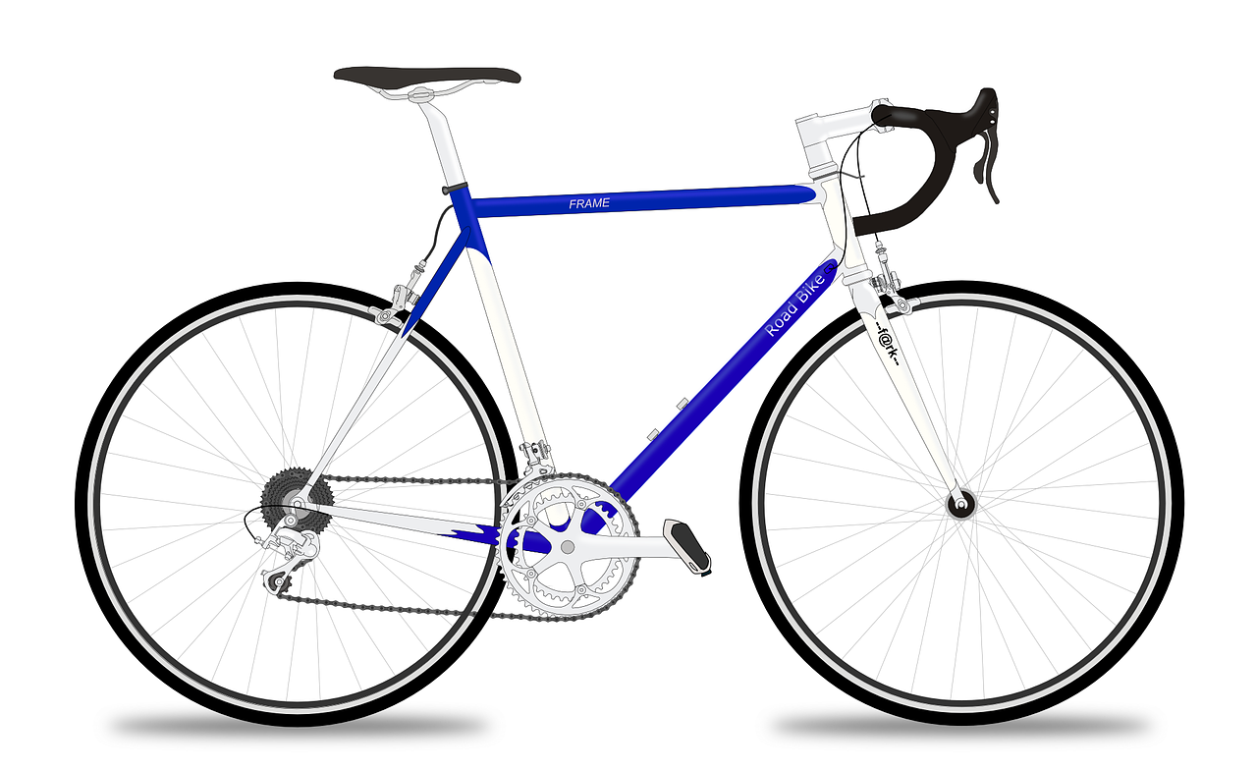
Activity 1
Handlebars
Seat
Frame
Wheel
Brake lever
Tyre
Brake cable
Spoke
Brake caliper
Sprocket
Brake pad
Chain
Front fork
Pedal
Can you name any parts of this bicycle?
Notes:
Image source: https://pixabay.com/vectors/racing-bicycle-racer-racing-bike-161449

Slide 5
Activity 1
Handlebars
Front fork
The handlebars are connected to the front fork. Moving the handlebars allows the rider to steer the bike. This could be called the steering system.
Notes:
Image source: https://pixabay.com/vectors/racing-bicycle-racer-racing-bike-161449

Slide 6
Activity 1
Handlebars
Seat
Frame
Wheel
Brake lever
Tyre
Brake cable
Spoke
Brake caliper
Sprocket
Brake pad
Chain
Front fork
Pedal
Can you describe a different system on this bicycle?
Notes:
Image source: https://pixabay.com/vectors/racing-bicycle-racer-racing-bike-161449

Slide 7
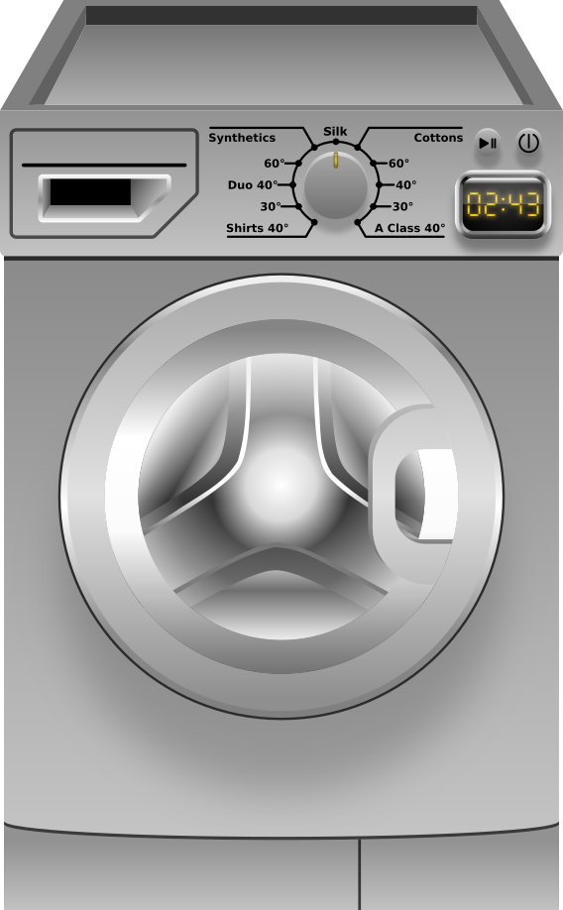
A digital system
Activity 2
The dials and buttons on the front of a washing machine are the inputs.
The computer inside the washing machine follows a program based on the inputs.
The clothes are washed and spun. The display indicates how long the wash is taking. These are outputs.
input
output
output
Notes:
Image source: https://pixabay.com/vectors/washing-machine-clothes-laundry-1994661

Slide 8



Designing a talking teddy
Activity 2
You’re going to design your own talking teddy.
It will need an input, process, and an output.
For example, if you press its paw, it will say “hello”.
Hello!
Notes:
Image sources:
https://pixabay.com/vectors/teddy-bear-bear-knuffig-cuddly-447415
https://pixabay.com/vectors/index-finger-pointing-pointer-hand-309826/
https://pixabay.com/vectors/button-red-round-shiny-155149/

Slide 9
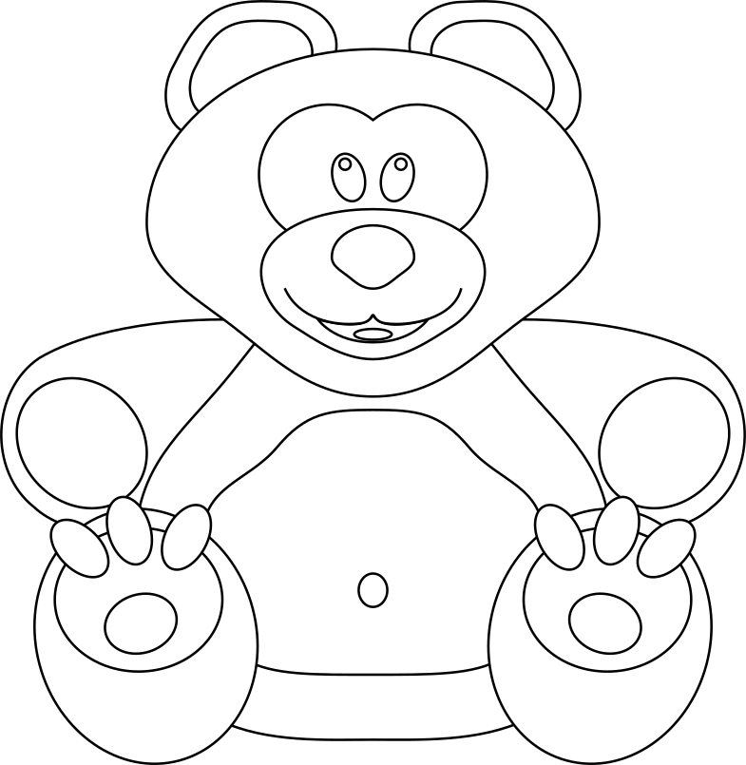
Task
Activity 2
Your design should include:
Parts you would need
Inputs
Process
Outputs
What else could you make it do?
Inputs
Outputs
Process
Notes:
https://pixabay.com/vectors/teddy-bear-bear-knuffig-cuddly-447415

Slide 10
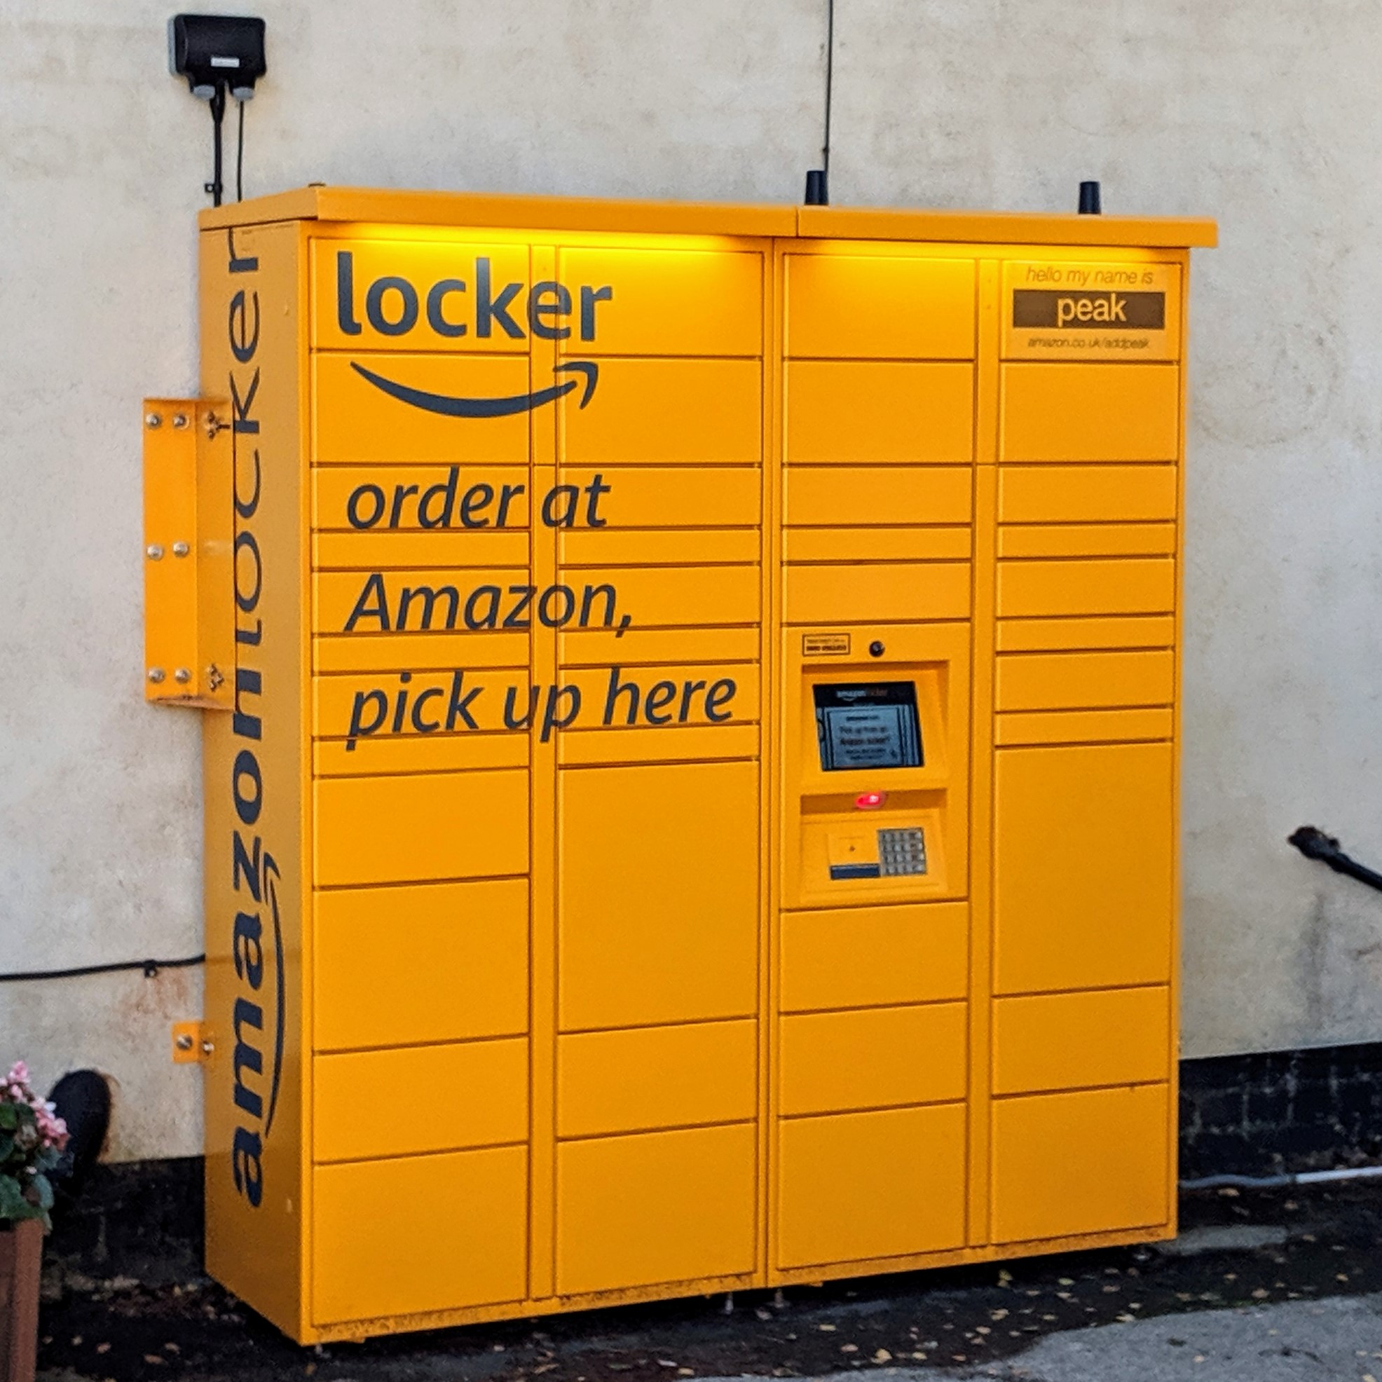
Computers in a system
Activity 3
This locker allows customers to collect items they have ordered online.
The customer is sent a code, which they can scan or key into the locker.
Describe what you think happens after the customer places their order.
Notes:
Image source: Raspberry Pi Foundation

Slide 11

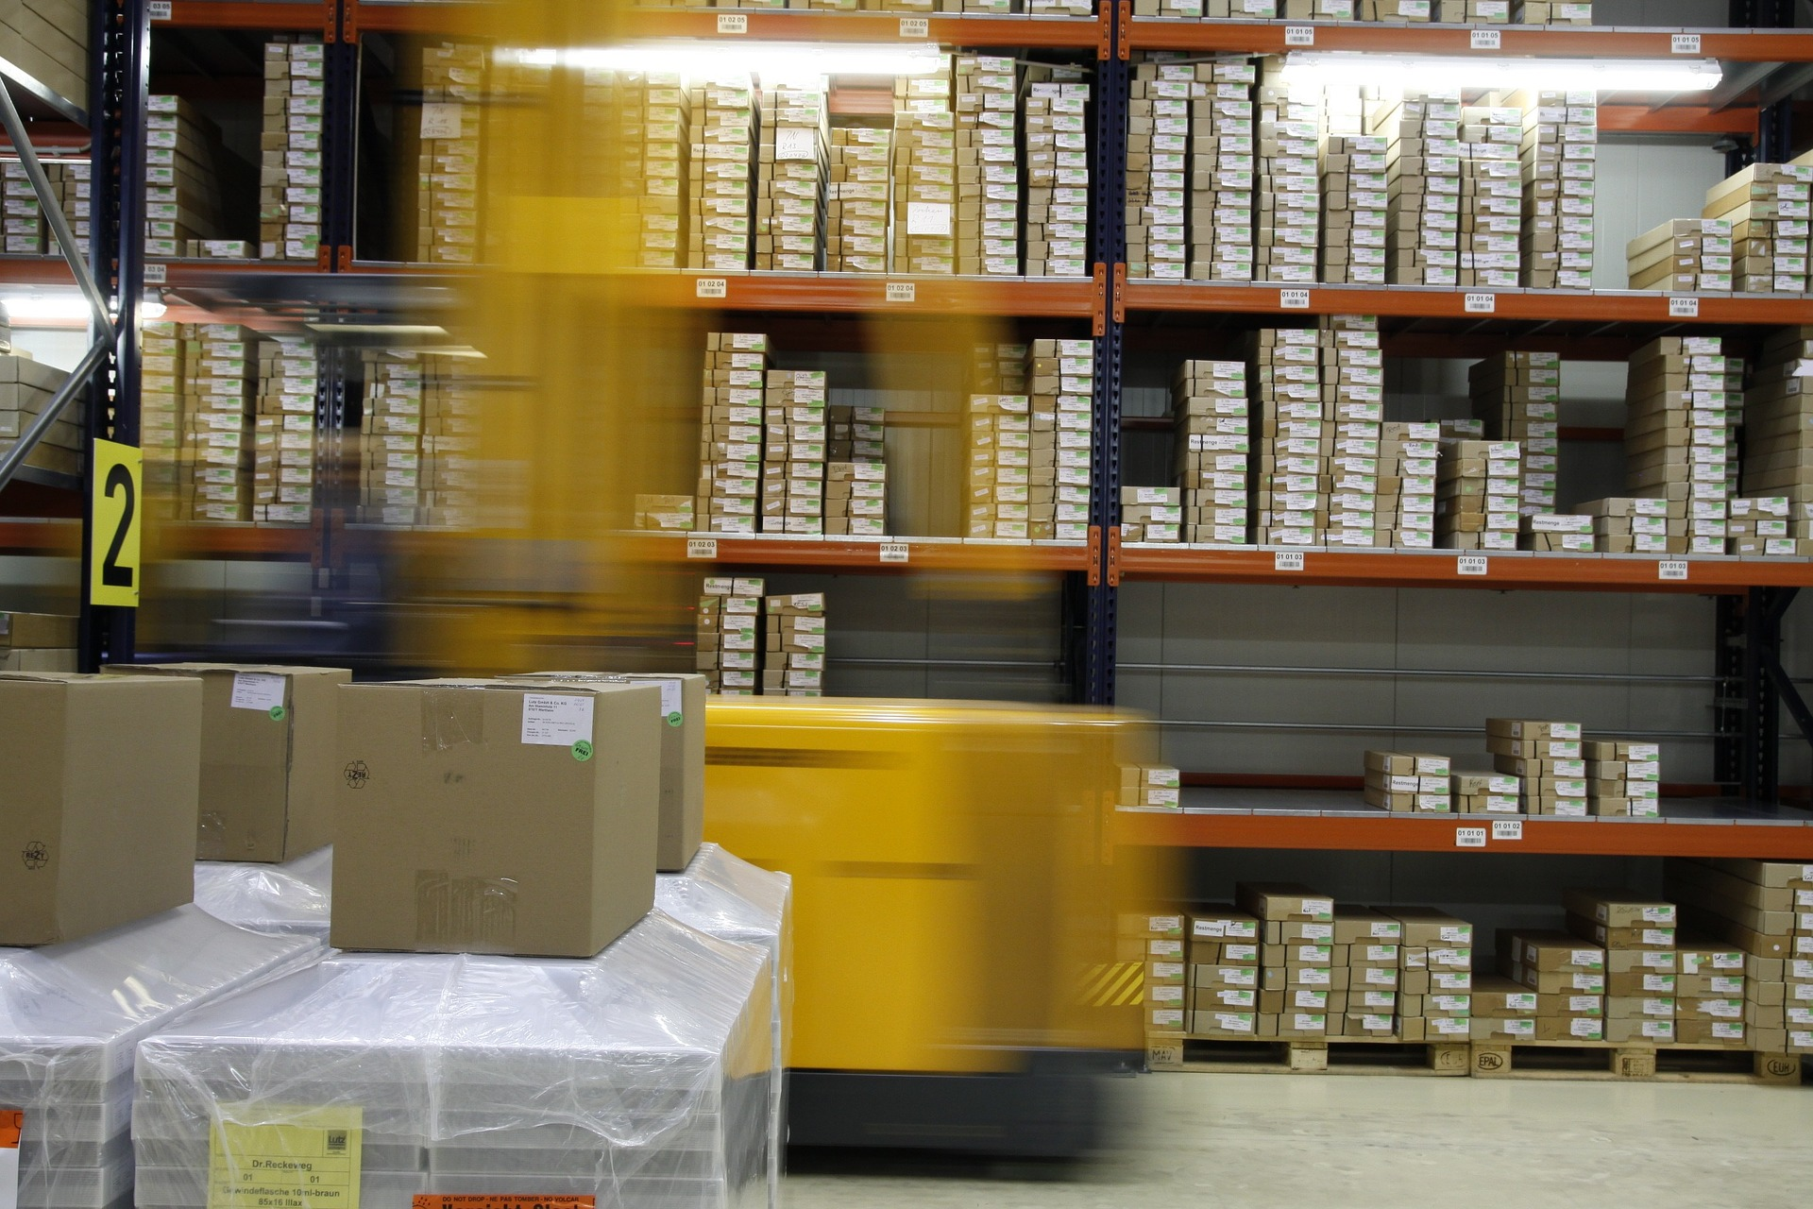

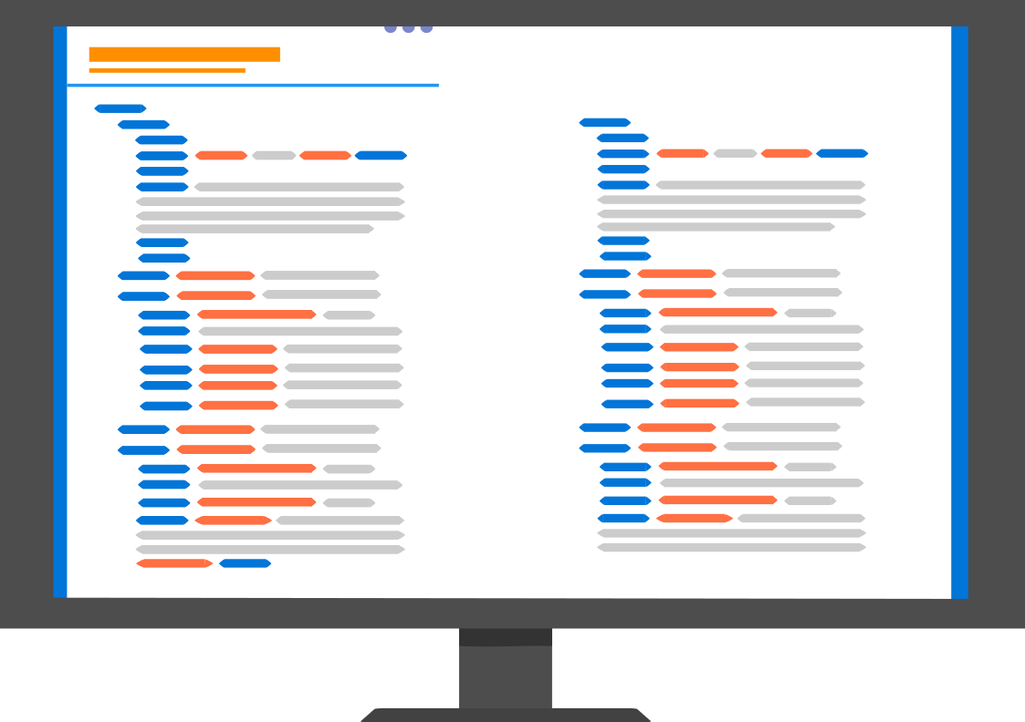

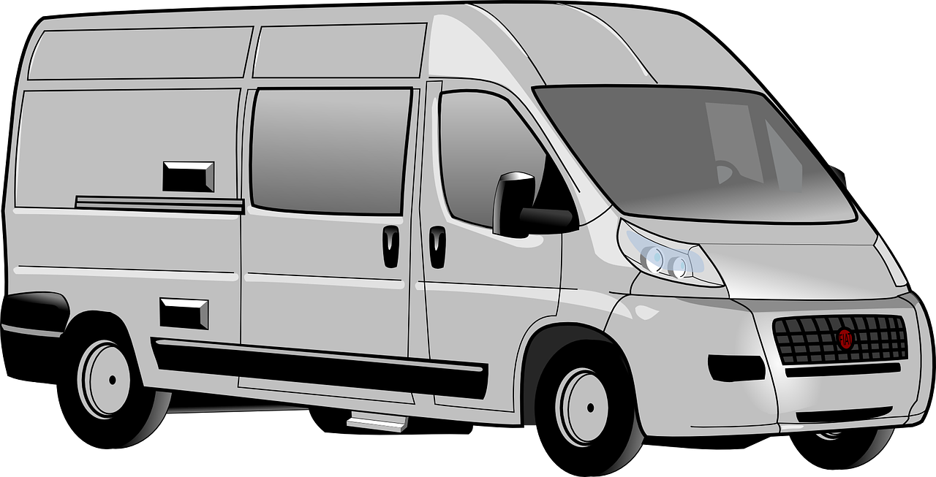
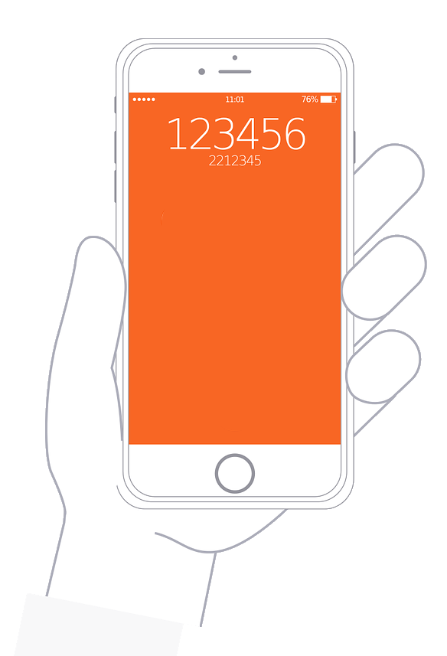

Smart locker
Activity 3
Notes:
Image sources:
https://pixabay.com/illustrations/computer-web-internet-apple-imac-908893
https://pixabay.com/vectors/browser-internet-www-global-98386
https://pixabay.com/vectors/custom-code-flat-icon-custom-code-2440939
https://pixabay.com/illustrations/box-packing-cardboard-package-686314
https://pixabay.com/vectors/box-paper-delivery-box-1252639
https://pixabay.com/vectors/box-cardboard-closed-carton-moving-40302
https://pixabay.com/photos/high-bay-stock-range-warenlager-408222
https://pixabay.com/vectors/minivan-automobile-transportation-41476
https://pixabay.com/illustrations/iphone-hand-smartphone-mobile-1935983
https://pixabay.com/illustrations/warehouse-shipping-box-business-3688280
Smart locker: Raspberry Pi Foundation

Slide 12
Plenary
Can you explain to the person next to you what a system is?
Notes:
Image source: https://pixabay.com/vectors/speech-bubbles-comments-orange-303206

Slide 13

Assessment
How confident are you? (1–3)
I can show that systems are built using a number of parts
I can describe the input, process, and output of a digital system
I can explain that computer systems communicate with other devices
3 – Very confident
2 – Unsure
1 – Not confident
Notes:
Image source: https://pixabay.com/vectors/thumb-up-hand-like-confirm-go-top-307176

Slide 14
Next lesson
Summary
In this lesson, you…
Recognised that systems are built up of lots of parts
Explored how the parts within different systems work together
Next lesson, you will…
Explore how devices and processes are connected in systems
Consider the benefits of computer systems

